Slide 1
Human Resources Update
For Executive Leadership
By Jessica Baxter
Turing College Module 2 Sprint 2 Project
Notes:
Hello and welcome to the human resources update for executive leadership. Today we will be discussing the ins and outs of the individuals on the Adventure Works team and the insights we can gain from their contribution to the company.

Slide 2
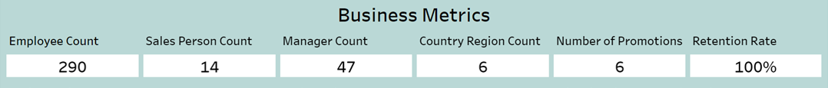
Adventure Works Company Overview
Notes:
Firstly, I would like to start with business metrics to see the overall health of the company. As you can see there are a total of 290 employees, 14 of those employees being salespeople and 47 employees in a managerial role. These employees work across a total of 6 different countries around the world. While there have only been 6 promotions over the past 8 years the retention rate is 100%.

Slide 3
What is happening?
Notes:
Why is this? What is happening?
There are a couple different theories.
One is fairly straight forward…..

Slide 4
What is happening?
No data about previous employees
Notes:
Adventure Works does not keep records of previous employees, they only keep records of current employees.
This could be the case, though it seems like more work to dispose of all the records of previous employees than just adding in an end date and being done with it. If this data has been disposed of, it would be difficult to know if or how many previous employees there have been.
Another theory is…

Slide 5
What is happening?
No data about previous employees
Actual 100% Retention Rate
Notes:
There is actually a 100% retention rate. It seems hard to believe that there truly hasn’t been any turn over over the past 8 years. But it’s also hard for me to believe that a company would dispose of all records of previous employees.
Let’s assume that this company actually has had a 100% retention rate over 8 years. Let’s look into that.

Slide 6
What is happening?
Send a survey out to employees
Notes:
If that were the case, what would be happening?
There are a couple ways we can understand why there is a 100% retention rate, especially considering there have been basically no promotions in the last 8 years.
We could send a survey out to employees to understand what keeps them loyal to Adventure Works.
This could help us understand what is happening and how we can continue retaining employees.

Slide 7
What is happening?
Send a survey out to employees
Survey management
Notes:
Since a big reason why employees tend to leave work places is poor management, we could survey management and get a feel for their management style.

Slide 8
What is happening?
Send a survey out to employees
Survey management
Do a pay comparison among competitors
Notes:
A big reason employees stay at their workplaces is they are being offered competitive rates for the work they do. I might recommend a study to compare the pay Adventure Works employees receive and the pay of competitors.
The average salary in the manufacturing industry is about $43,864 a year, or $21.09 an hour. While the average pay at Adventure Works ranged from $18-$31 depending on the year. This sits about average nation wide, though it might be useful to compare pay to local companies to see how they compare. Pay can depend greatly depending on location.

Slide 9
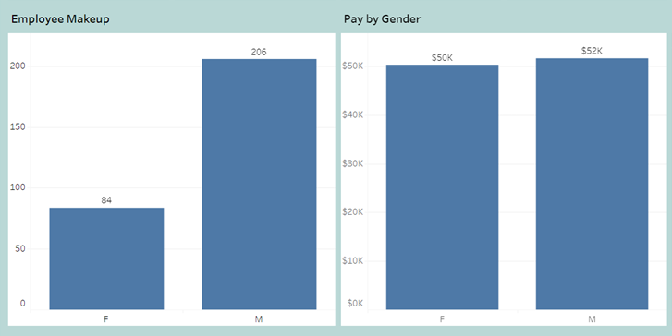
Makeup and Pay of Employees
Notes:
The total makeup of employees is very uneven. There is about a 2.5x difference between how many men vs women working at Adventure Works.
Despite this, the massive difference, they are being paid very similarly.

Slide 10
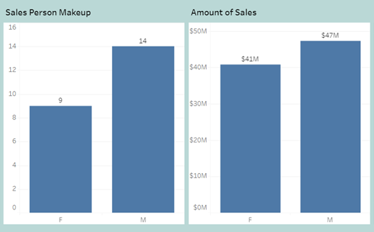
Makeup and Sales of Salespeople
Notes:
To look at this another way, I looked into the makeup of salespeople. Again, we see a bit of a disparity between the number of women and men in this role, but it not as vast a difference like between the total number of men and women who work at the company.
Once again, when looking at the amount being brought in by sales, women and men bring in very similar numbers through sales.

Slide 11
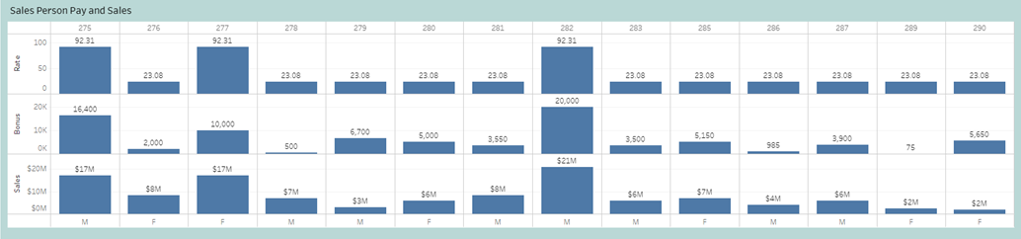
Amount in Sales
Notes:
When breaking down salespeople by what they make in pay and bonuses and what they bring in sales and we see something interesting.

Slide 12
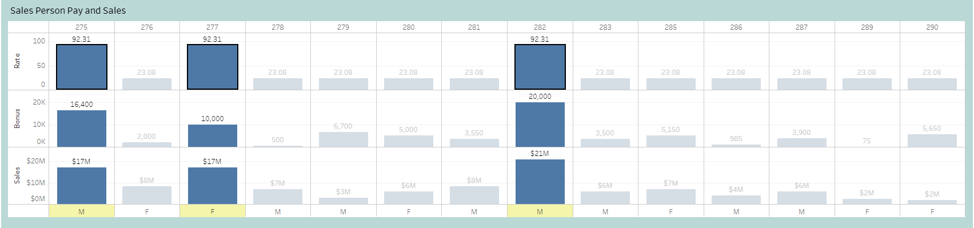
Amount in Sales
Notes:
There are 3 top earners on the sales team. They bring in the most in sales, and they earn the most in pay and bonuses.

Slide 13
What can we do?
Notes:
What can we do with this information? How do we keep growing? Let me give some recommendations.

Slide 14
What can we do?
Send a survey out to employees
Survey management
Do a pay comparison among competitors
Notes:
Like we talked about earlier, we can send surveys to employees to ensure retention. We can survey management to understand their management style. And we can compare our pay rates with those of our competitors to ensure our employees are getting competitive rates, ensuring they stay employed with us.
But what else can we do?

Slide 15
What can we do?
Send a survey out to employees
Survey management
Do a pay comparison among competitors
Who made the most sales in 2001?
Notes:
We can utilize our top salespeople to help the entire team. We can have these employees do workshops for the rest of the sales team to boost sales among the whole team, bringing more money in for the company.

Slide 16
Thank you for your Time Questions?
Notes:
Thank you for your time. Are there any questions?

